Slide 1

LaunchCode Liftoff
Class 7
Hank DeDona
6/1/2020

Slide 2
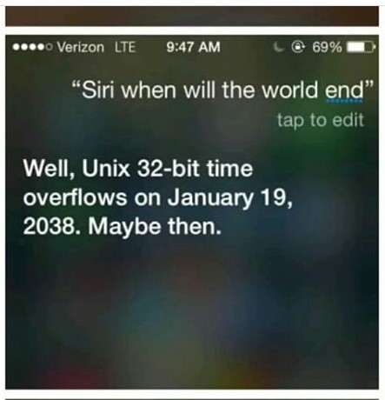
Agenda
Lecture
Building a Portfolio
Deployment
Assignment - Project Presentation
Q&A
Activity
Scrum
Paired Interview Practice
Open Work Time

Slide 3
Liftoff Project Timeline
Address Feedback
Next Features
Behavioral Interviews
Class 5
Class 7
Class 6
Class 8
Next Features
Final Review
Notes:
Resume Aug 21st

Slide 4
Announcements
Last Class
June 8th
Assignments Due
June 8th
Sign up for LC101 (next cohort) ends (tell your friends)
June 9th

Slide 5
The End is Near!
Required:
Project Outline
Project Planning Assignment
Project (Repository) Setup
Online Profiles
Project Review
Live Coding Exercise
Mock Interview Exercise
Project Presentation
If you are missing any of the assignments, submit them in canvas and let your mentor know
If you are missing any of the in-class exercises, reach out to your mentor or John to schedule time to meet
All assignments are due June 8th

Slide 6
Building a Portfolio

Slide 7
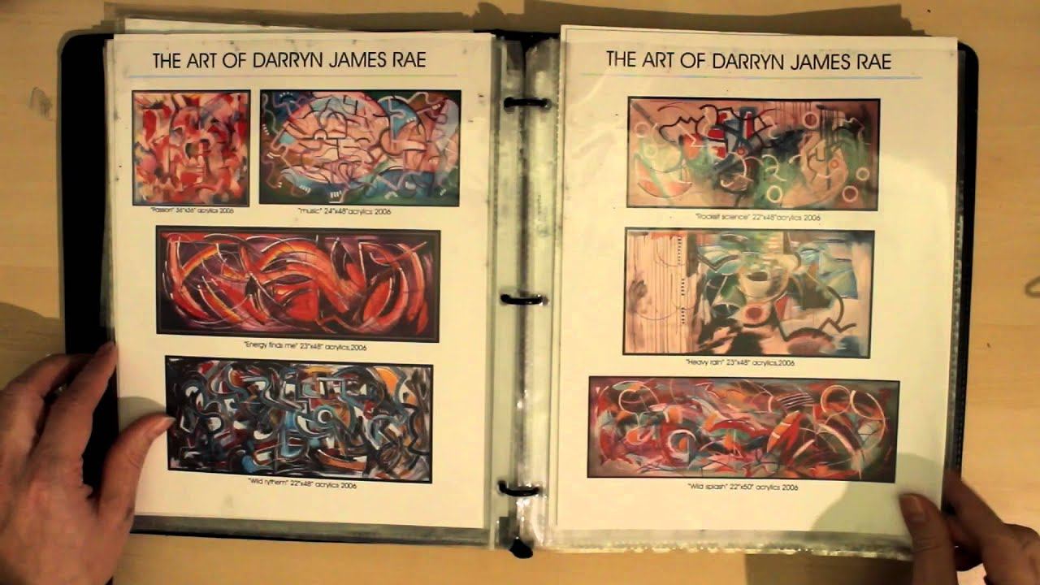
Why Build a Portfolio
Like an Artist’s Portfolio
Easy to Share Your Work
Potential Employers and Recruiters
Tonight’s Assignment

Slide 8
Deployment Overview
Notes:
Deploying Your App - Optional, but good to have
Language Agnostic - See Tonight’s “Project Deployment” optional assignment for recommendations

Slide 9
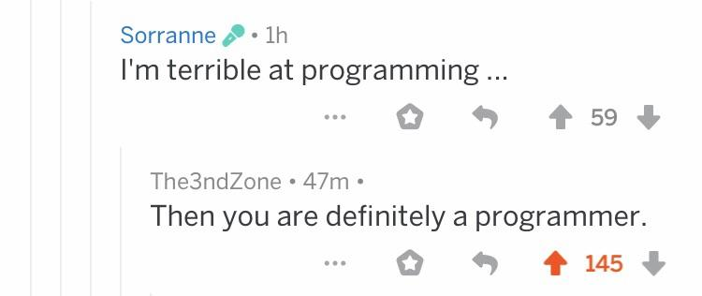
Why Deploy Your App?
Show Your Friends, Amaze Your Family!
Become The Next Facebook!
Woo Potential Employers!
Learning ‘Higher Level’ Concepts
The Cloud and DevOps

Slide 10

How Is It Done?
Each Company and Team Is Different
Most Teams Have a “Test/Dev” and “Prod” (Sometimes a “sandbox”)
May Have an Operations Team for DevOps
May Be Responsible For Your Own Apps
On-site vs Hosted (AWS, Azure, etc)

Slide 11

So Many Choices
Hardware vs Cloud
Static vs Dynamic Hosting
Infrastructure as a Service (IaaS)
AWS
Google Cloud
Azure
Platform as a Service (PaaS)
Pivotal Web Services
Heroku
All of the Above
Considerations
Cost
Performance
Scalability
Managed Services
Vendor Lock-In
Notes:
Hybrid Cloud

Slide 12
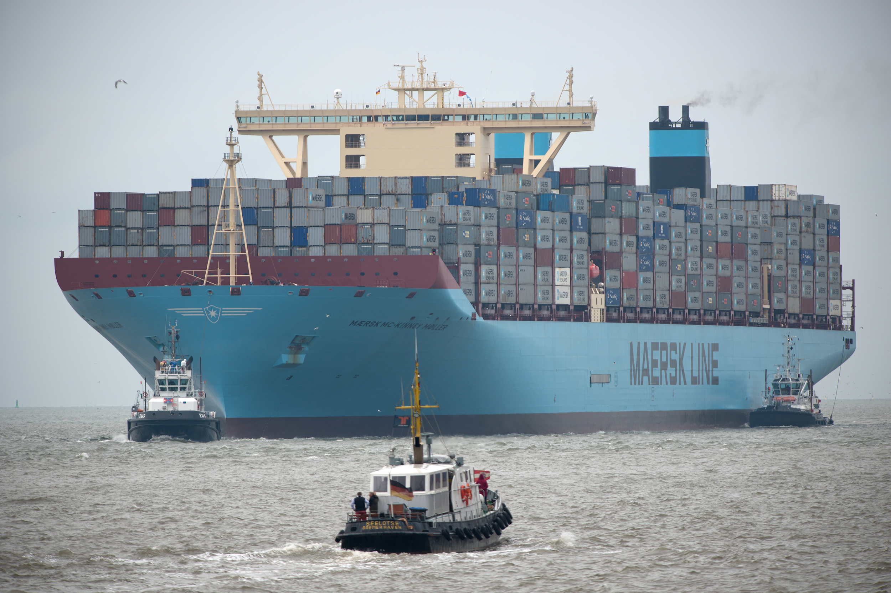
Other Concepts
Continuous Delivery - Automated Testing and Deployment
Software as a Service - 3rd Party Software Functionality
Virtualization - Virtual Version of Hardware (e.g. VMWare)
Containers - Stand-alone, executable software package (e.g. Docker)
DevOps - Deploy and Run Your Software

Slide 13
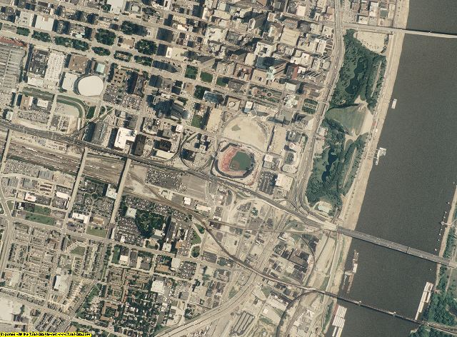
The 10000 Foot View
Create Deployable Artifact (JAR or WAR)
Provide Deployment Context (Manifest, AZUREDEPLOY or AMI)
Provision Database Resources
Configure Routing (External and Database)
Setup Secrets/Credentials (services and env vars)
Upload and Deploy Tool
Notes:
C# - Deploy straight from VS2017

Slide 14
Objectives
How to talk about your project
Parts of an interview
What you may encounter in a technical interview
How to answer technical questions
What to do if you don’t know how to answer
Using project and class experiences for technical questions

Slide 15
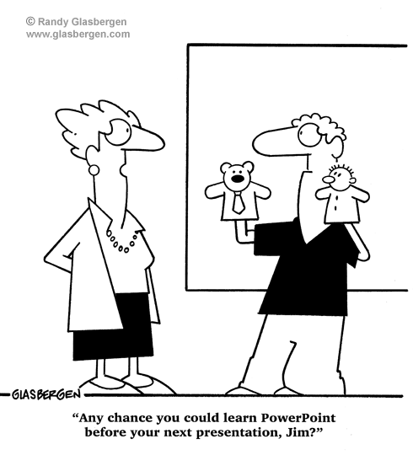
Assignment - Project Presentation
Assignment
Create a Slide Deck Presentation
Overview of Your Project
Technology Stack
Features
Accomplished to Date
Goal: Prepare You for Interview

Slide 16
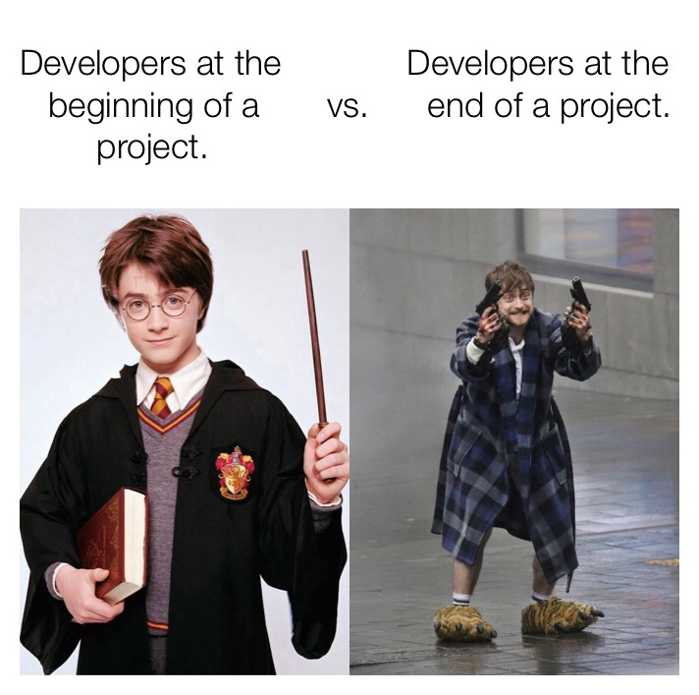
Activity - Scrum
What you’ve finished
What you’re working on next
Any blockers

Slide 17
Q&A?

